Slide 1
Understanding what an endpoint is and the role it plays in security
1
2
Why the data on endpoints is valuable
3
Protecting and education around user good practises
4
Some of the challenges faced by administrators
5
Gold builds and hardening considerations
Notes:
Context: This slide gives you the reasons for understanding Endpoint Security.
Say:
Ask:
Do: Read out the slide contents and explain it to the participants.
Tip: Seek acknowledgement for understanding of the slide contents.
--------------------------------------------------------------------------------------------------------------------------------------------------------------------------------------Original notes:
This Module
Built on the assumption of a user device/workstation. There might be a lot of overlap with Awareness here?
Could leave a couple of ‘random’ USB sticks in the room and see if people freely plug them in without questioning? Immediately get them to recognise they have done something bad. First hand experience of why USB media is bad.

Slide 2
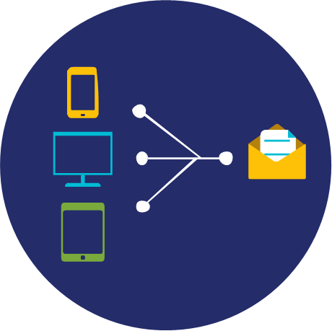
What is an endpoint?
Notes:
Context: This slide is in continuation to the previous slide and talks about why endpoint matters in the overall security scenario.
Say:
Ask:
Do: Read out the slide contents and explain it to the participants.
Tip: Seek acknowledgement for understanding of the slide contents.
--------------------------------------------------------------------------------------------------------------------------------------------------------------------------------------Original notes:
Ask the class what their definition of an endpoint might be.
Basically, any end device that communicates with a server.
Laptops, phones, etc.

Slide 3
Endpoint – An endpoint is a computing device which connects to a network and communicates with that network. They are the end (or start) of an information flow
Endpoint Examples:
Desktops
Laptops
Smartphones
Tablets
Servers
Notes:
Context: This slide defines endpoint and gives its examples.
Say:
Ask:
Do: Read out the slide contents and explain it to the participants.
Tip: Seek acknowledgement for understanding of the slide contents.
--------------------------------------------------------------------------------------------------------------------------------------------------------------------------------------Original notes:
Endpoint specifically is usually the ‘last hop’ i.e. data starts and ends there.
‘Devices’ is the more generic term for any device, including routers and switches etc.

Slide 4

User endpoint or user devices – such as tablets, phones, laptops, workstations, ATMs, Kiosks
Increasingly, endpoints are the target for malicious activity. But why? (Quiz)
Components of User Endpoints - Type in each heading below more (Quiz)
Datacentre endpoint or Cloud devices – such as Servers, Virtual Servers, Containers, Serverless App Engine
Increasingly, servers are target for malicious activity. But why?
Components of Server– Type under each heading 2 more examples (quiz).
Hardware - RAM, GPU
Driver - Printer, N/W driver
OS - Windows 10, Kali
Apps - Word, Browser
Hardware - RAM, Tape drive
Driver - Printer, USB driver
Hypervisor - Vmware
OS - Windows 2022, Red hat
Container - Docker
Services - Apache
Applications - SAP, Database software
Notes:
Context: This slide provides the learners with a platform to deliberate further on the importance of endpoint security.
Say:
Ask:
Do: Read out the slide contents and explain it to the participants.
Tip: Seek acknowledgement for understanding of the slide contents.
--------------------------------------------------------------------------------------------------------------------------------------------------------------------------------------Original notes:
Numerous conversation elements here.
Suggestions on why endpoints are both risks and targets:
Endpoints travel in and out of corporate offices
Endpoints may contain sensitive corporate data
Endpoints can be stolen
Endpoints may contain VPN permissions back to corporate offices
Endpoints connect via wifi – often in insecure locations – like coffee shops
Many endpoints do not have anti-malware installed – such as smartphones. Anti malware is available, but is often not installed and used. Ask class how many have AV on their phone.
Endpoints are used by people – who are fallible. They click on things they should not click…

Slide 5
Common endpoint risks and threats:
Malware – virus, worm, trojan
Ransomware
Phishing / spear phishing
Spyware
Sensitive Data
Weak passwords
Physical theft / loss / destruction
Notes:
Context: This slide lists the common endpoint risks and threats.
Say:
Ask:
Do: Read out the slide contents and explain it to the participants.
Tip: Seek acknowledgement for understanding of the slide contents.
--------------------------------------------------------------------------------------------------------------------------------------------------------------------------------------Original notes:
Invite the class to offer additional risks – and to offer any examples they have of these risks being actualized.

Slide 6

Endpoints are targets because:
They have access to the network and often operated by non IT (your son, mother) folks. Enduser Networ
Endpoint users can be a weak link in the security chain. However, with the right training, users can be the strongest link!
Notes:
Context: This slide gives you the reason for endpoints being a target.
Say:
Ask:
Do: Read out the slide contents and explain it to the participants.
Tip: Seek acknowledgement for understanding of the slide contents.
--------------------------------------------------------------------------------------------------------------------------------------------------------------------------------------Original notes:
Point out that user awareness training and good security hygiene is important.
If trained, users can be a strong additional control within a network, being suspicious of emails that get past filters, not opening attachments, phoning support if something unusual happens.

Slide 7
Individual Quiz
Why Endpoint Matters
Notes:
Context: This slide is the landing page of the activity detailed on the next page.
Say:
Ask:
Do: Read out the slide contents and explain it to the participants.
Tip: Seek acknowledgement for understanding of the slide contents.
--------------------------------------------------------------------------------------------------------------------------------------------------------------------------------------Original notes:
Exercise – Endpoint Attack Research
Estimated time: 30 minutes
{Hand out exercise}
This exercise is designed to get people thinking about the attack surface offered by endpoints. The general notion is to have the class research attacks to endpoint and present the top findings. The real impact should come from their realization that the user is often responsible for facilitating the attack – i.e. the user clicks on a phishing link, leaves the laptop unlocked when they step away, etc.
It is also an exercise designed to figure out who might have some endpoint knowledge. Some of the class participants hold help-desk or endpoint related jobs and they can likely offer the class some anecdotal stories….
The Instructor should walk around interacting with each pair briefly as they deliberate.

Slide 8
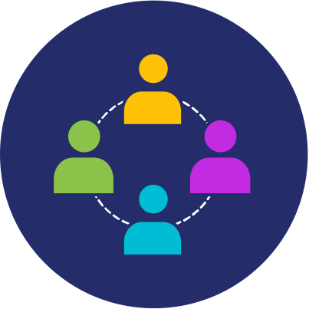
Task = Research the Top 5 most common threats to endpoints.
Break into teams of 2 and complete the worksheet.
Post-research class discussion: How many of the attacks found in your research are facilitated by the end user? For example, the attack relied upon a user’s action.
Notes:
Context: This slide details the endpoint activity’s instructions.
Say:
Ask:
Do: Read out the slide contents and explain it to the participants.
Tip: Seek acknowledgement for understanding of the slide contents.
--------------------------------------------------------------------------------------------------------------------------------------------------------------------------------------Original notes:

